Slide 1


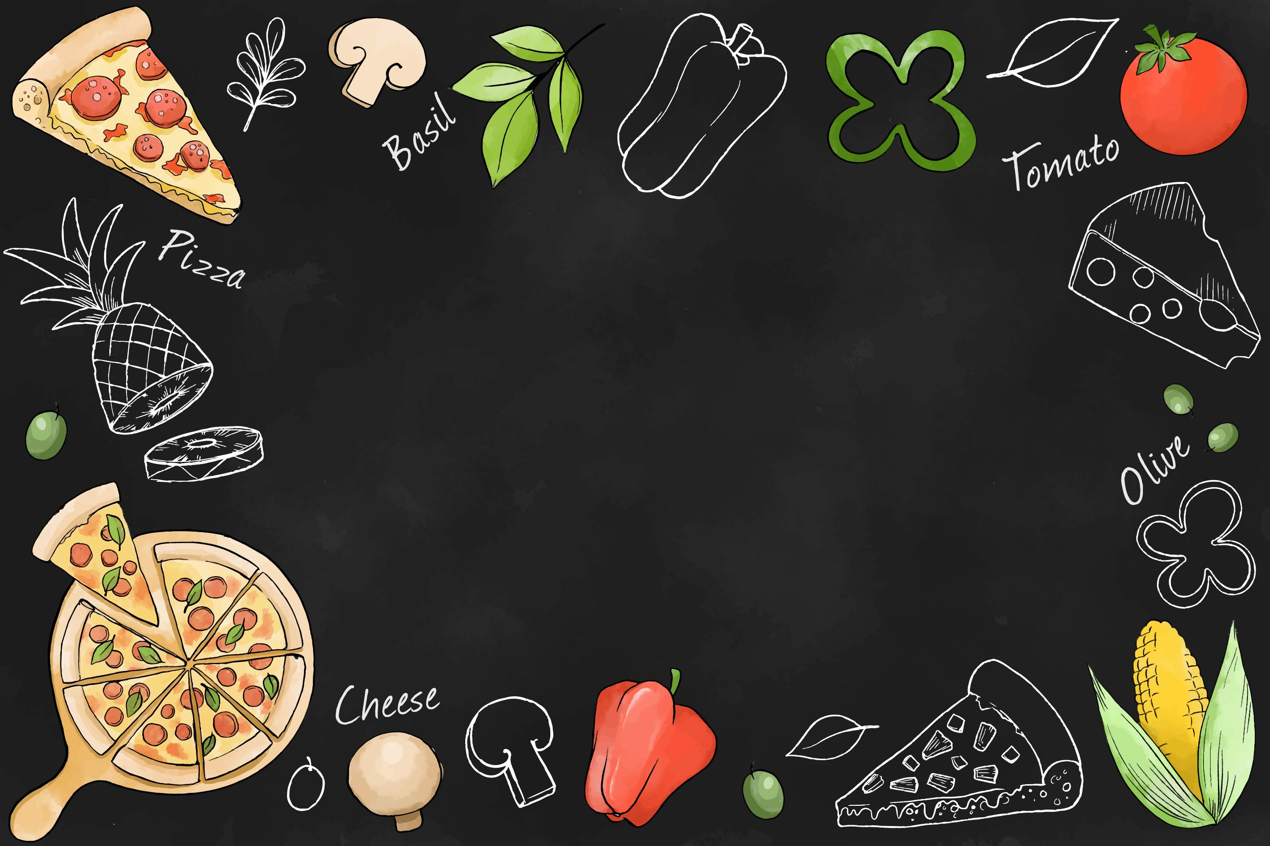
Pizza hut
SALES ANALYSIS
Presented by
Rohini

Slide 2
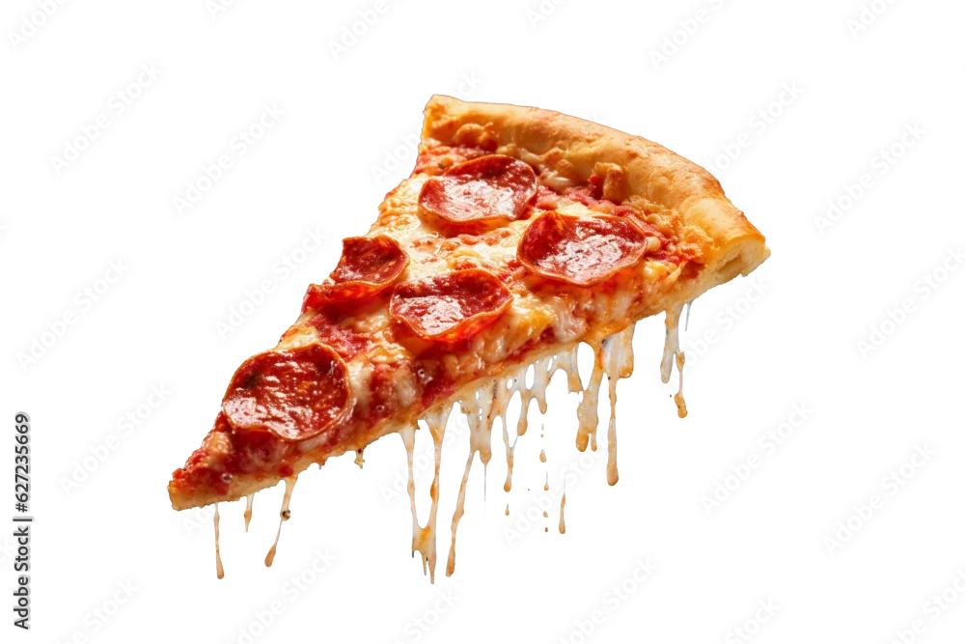
OBJECTIVE
To analyze pizza hut sales data using SQL in order to understand customer behavior, revenue trends, and pizza preferences
And to apply data analysis techniques to Real- business scenarios.
Identify the most popular pizzas.
Understand order trends by time of day
Revenue, and product preferences
Track average daily orders and growth

Slide 3
PROBLEM STATMENT
This project focuses on analyzing pizza hut’s sales data using SQL to convert raw transaction records into meaningful insights.By examining pizza types, quantitessold, prices, and customer behaviour, the analysis identifies top-selling items ,revenue trends, and demand patterns. these insights enable better decision-making, helping optimize inventory, improve customer satisfaction, and enhance operational effiency.
The transforming large, unstructured datasets into actionable strategies, showcasing its value in the food and enhance customer satisfaction and support data-driven business operation.

Slide 4
INTRODUCTION
• Pizzas
• Pizza_types
• Orders
• Order_details
Data includes pizza details, order timings,
size., and price
Data set link
https://drive.google.com/drive/folders/14IaODHUAeZX548A74cDEunsmNVL6znlc?usp= drive_link

Slide 5

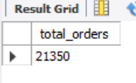
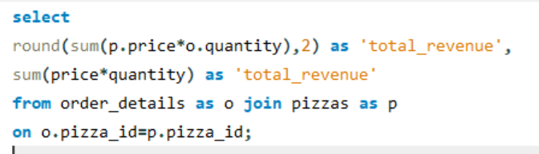
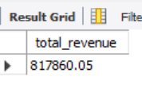
BASIC ANALYSIS
1.TOTAL ORDERS PLACD
Out put
TOTAL REVENUE CALCULATION

Slide 6
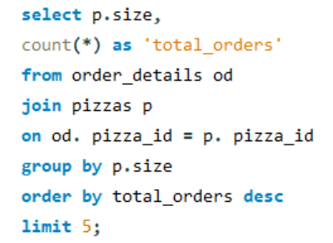
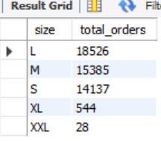
most order pizzas size
Out put

Slide 7
INSIGHTS
The most ordered pizza size (commonly medium or large) indicates customer preference
For group sharing and value-for- money deals.
Total revenue reflects strong sales performance for pizzas.
Medium / Large sizes are the most preferred by customers.
High total order count shows strong customer demand.

Slide 8
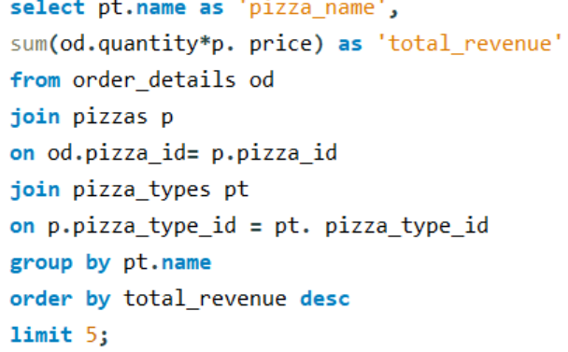
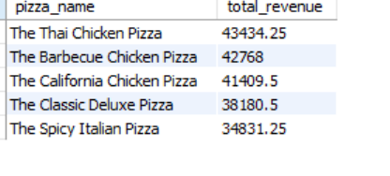
INTERMEDIATE ANALYSIS
Pizza type total revenue

Slide 9
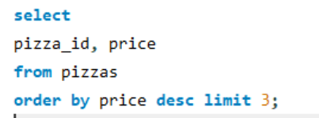
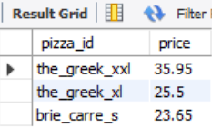
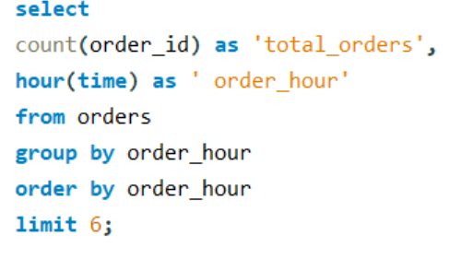
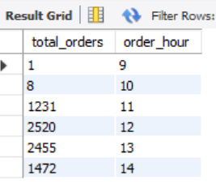
Most expensive pizza
Order trends by hour

Slide 10
INSIGHTS
These Pizzas represent Customer favorites and can be used for promotions,
Combos, and upselling.
The most Expensive pizza generates premium positioning, even if order
frequency is low.
Customers prefer affordable Best- sellers at peak hours,
But some segments are drawn to premium, High-value pizzas.
A small set of pizzas contributes a large share of overall
revenue.

Slide 11
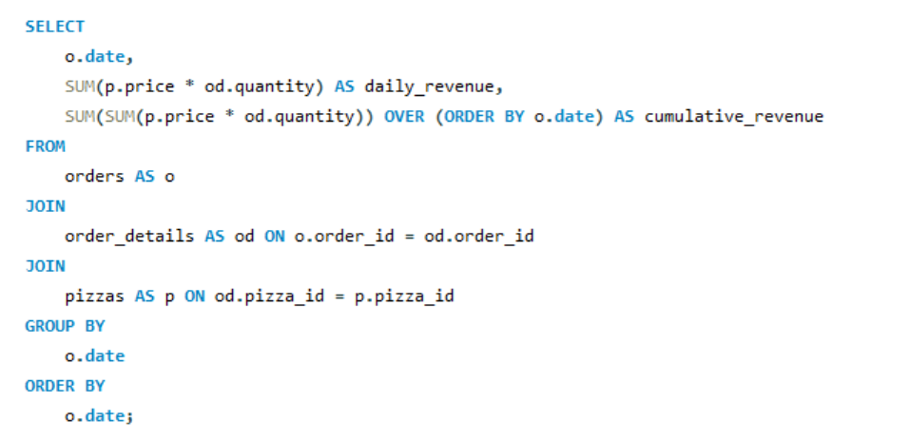
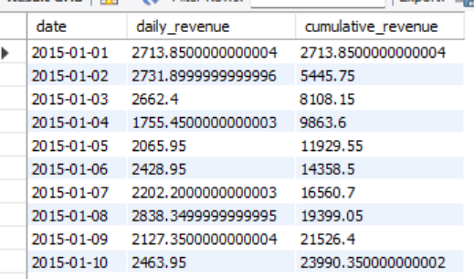
ADVANCED ANALYSIS
Cumulative Revenue over time
Out put

Slide 12
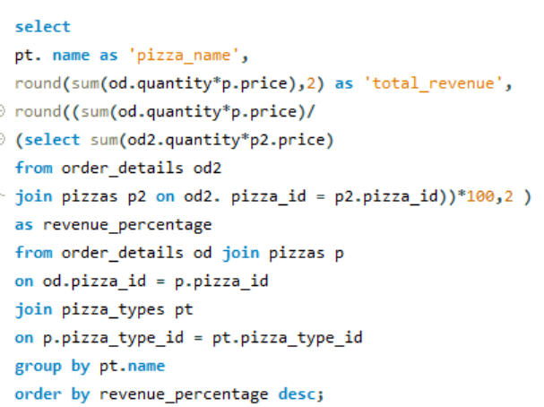
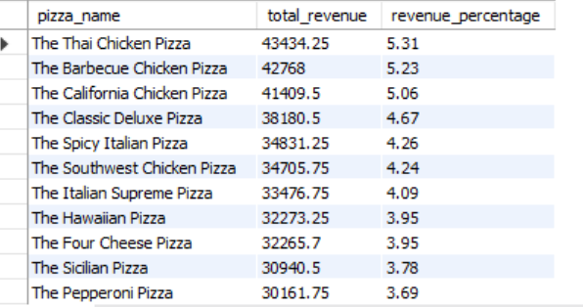
Revenue contribution by pizza type
Output

Slide 13
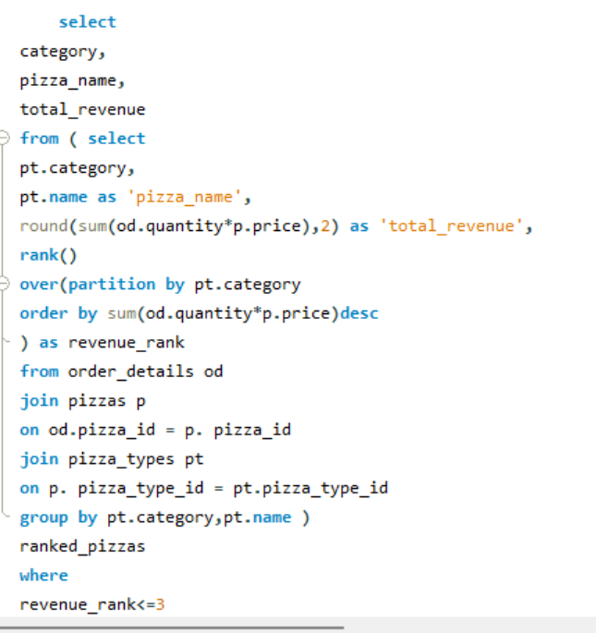
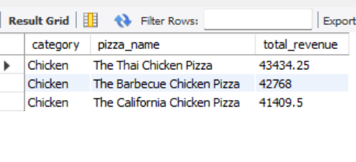
Top 3 pizza type by revenue in each category
Output

Slide 14
INSIGHTS
Revenue Distribution by Pizza Types Certain pizza types (like
classic or Supreme) Contribute a large percentage of total Revenue.
In every category (e.g., Veggie,Chicken,Supreme), there
are 3
Best _selling pizzas driving most of the
revenue, suggesting that focusing on them can maximize
sales.
Revenue grows steadily over time with Spikes on weekends and special
Occasions, highlighting when demand is highest

Slide 15
RECOMMENDATIONS
Promote best-sellers – Focus marketing on top 3 pizzas in each category since they drive most revenue.
Create combos or offers with high- priced pizzas to attract premium customer.
Plan campaigns around weekends, festivals, and holidays when demand is highest.
CONCLUTION
The analysis of pizza hut sales data using SQL provides valuable insights into customer
Preferences, revenue trends, and operational patterns. The result shows that a few top
Pizzas generate the majority of revenue, while Medium and Large size are the most popular
Over all, the study demonstrates how data analysis can support better decision – making and help Pizza Hut maximize growth and customer satisfaction.

Slide 16
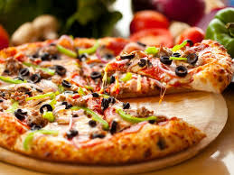
Thank you

